Slide 1
OOP Methods

Slide 2
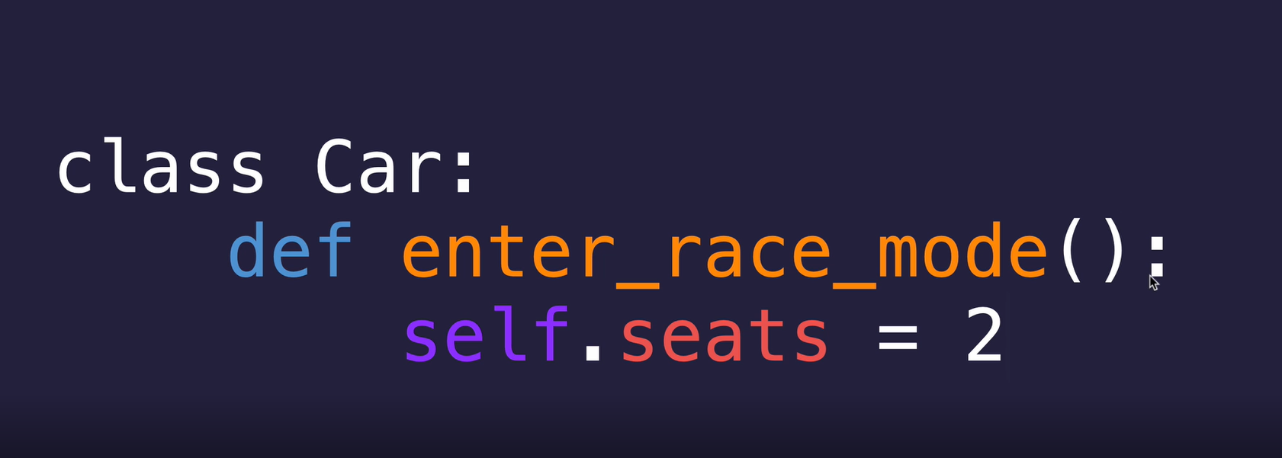
Adding Methods to Class
Previously we talked about attributes. Now, Let’s talk about methods.
Attributes are the entity that an object has i.e. It represents the characteristics of an object.
Methods are the entity that tells what work an object can do. i.e. The things that an object can perform.

Slide 3
TALKING OF METHODS
Unlike functions, methods always needs to have a “self” parameter as the first parameter. This basically means that whenever that particular method is called, it knows the object that called it.

Slide 4
Methods
In Python
Let’s start with an example

Slide 5
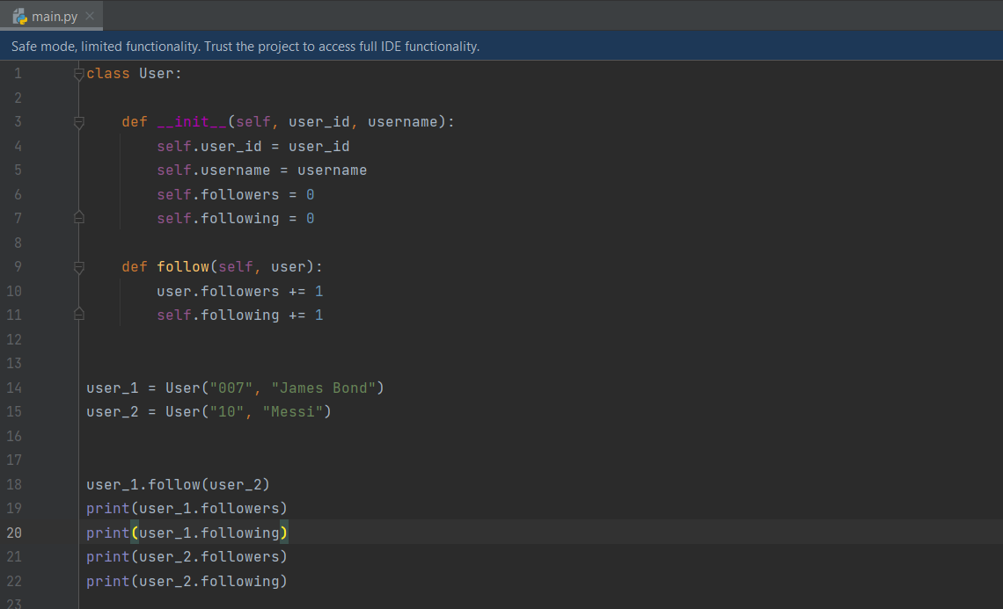

Slide 6
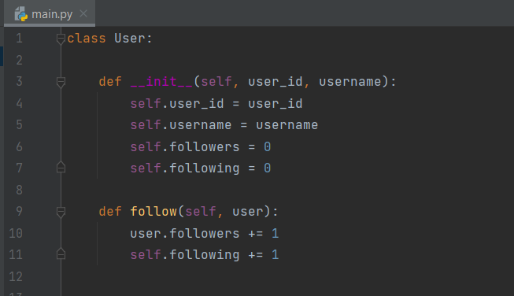
Explanation of example
First, we created a class and called it “User”.
We used constructor function to initialize variables.
We also defined a method called “follow”.

Slide 7

While creating objects, Our class will take two arguments. First one is user_id and the second one is username. Also, when the object is created, the followers and following of object is initialized at 0.

Slide 8
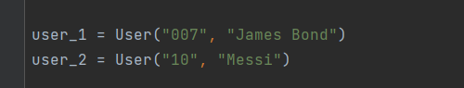
Explanation of example
Now, we created two objects called “user_1” and “user_2” from class “User” with some parameters.
We already know that “follower” and “following” attributes of both “user_1” and “user_2” are initialized at zero.

Slide 9
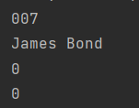
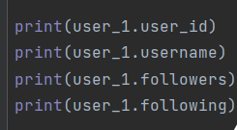
Output of the code in RHS

Slide 10
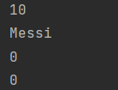
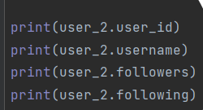
Output of the code in RHS

Slide 11
We can see that objects are initialized with certain values.
Assume that user_1 followed user_2. Now, the follower and following needs to be updated. But how can we achieve that?

Slide 12
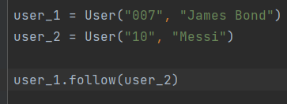
Explanation of example
For that, we have created a method called “follow”.
We can see that the method “follow” have two parameters: “self” and “user” where self is the object that calls the method “follow”and user is another object passed as parameter.
Let’s say that when an object follows another object, “follow”method is called by following object.

Slide 13
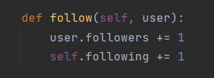
Explanation of example
In the code, we can see the line “self.following += 1 & user.follower +=1”.
It means that one object followed another object represented by “user”. Now, the method is called by the follower object so, self.following is updated by 1. Similarly, object represented by “user” is being followed. So, user.follower is updated by 1.

Slide 14
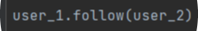
Explanation of example
Let’s look at line “user_1.follow(user_2)”.
This line means that the “user_1” has called method “follow” with “user_2” as parameter. i.e. “user_1.following” & “user_2.follower” both should increase respectively by 1.
Let’s look at output!

Slide 15
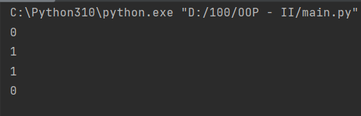
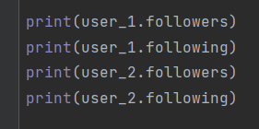
Output of the code in RHS

Slide 16
Thank You!!!

